Slide 1
Keithley I-V Control GUI
User Guide
Work Summary
Until 01/07/2025
Yichao Wang

Slide 2
What this app does
This GUI runs voltage sweeps on a Keithley SourceMeter (2600-series TSP commands supported), acquires I–V data, shows a live I–V plot in a popup, and produces a final analysis plot with a linear fit and sweep segments. It also saves your parameters, lets you reload named configurations, and exports plots/data.
It also supports “offline mode” (no PyVISA): the app will simulate data so you can test the workflow/UI.

Slide 3


Requirements (Softerware)
Python 3.9+ (recommended)
Python packages: numpy, pandas, matplotlib, mplcursors, tkinter (builtin on most systems), pyvisa (optional for real device), openpyxl or xlsxwriter (optional; for saving .xlsx)
Local modules:
If is not installed, the app prints a warning and runs in offline simulation mode.

Slide 4
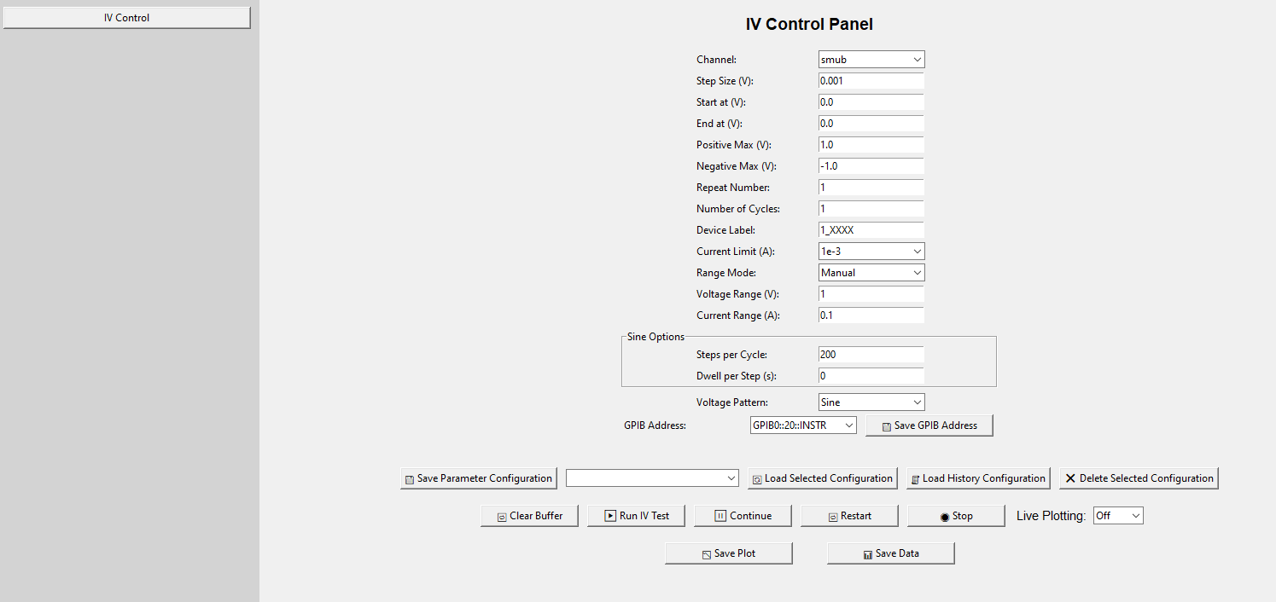
Layout of the whole GUI

Slide 5
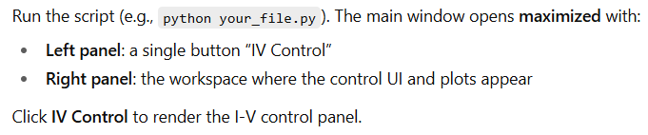
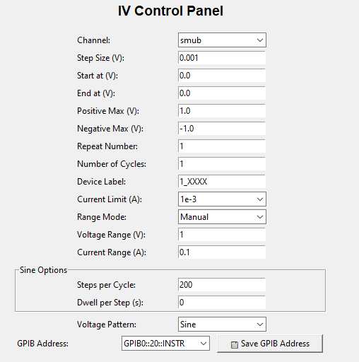
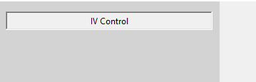
Launching the app

Slide 6
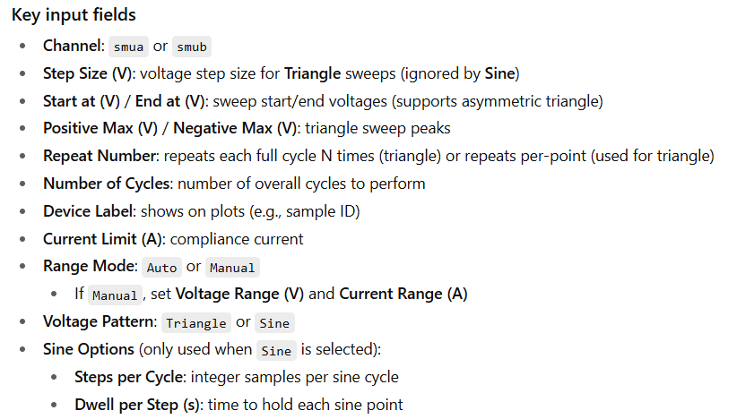
UI overview (IV Control Panel)

Slide 7
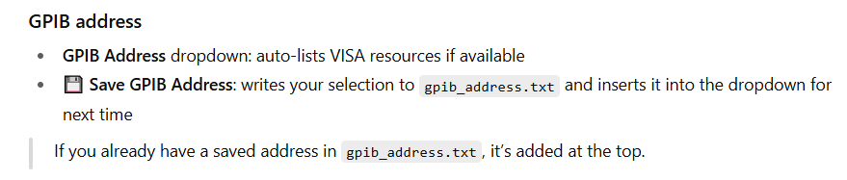
UI overview (IV Control Panel)

Slide 8
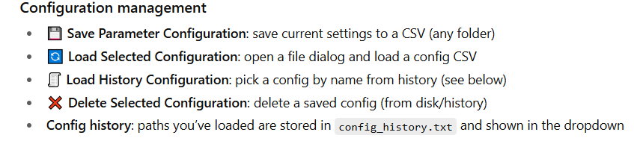
UI overview (IV Control Panel)

Slide 9
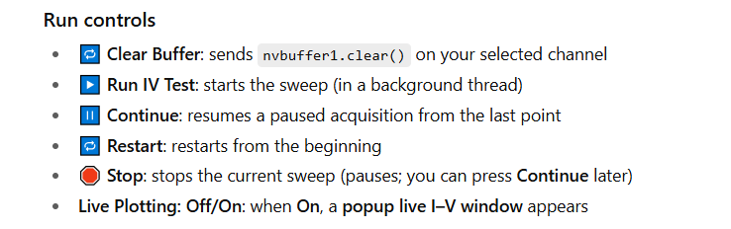
UI overview (IV Control Panel)

Slide 10
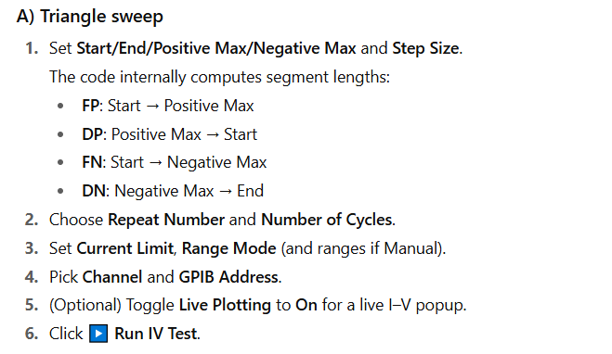
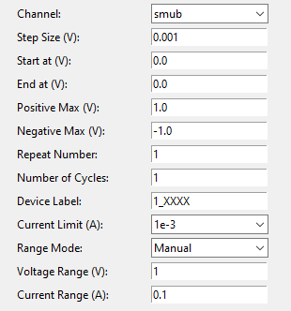
Typical workflows (Triangle Wave)

Slide 11
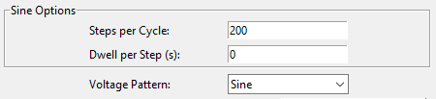
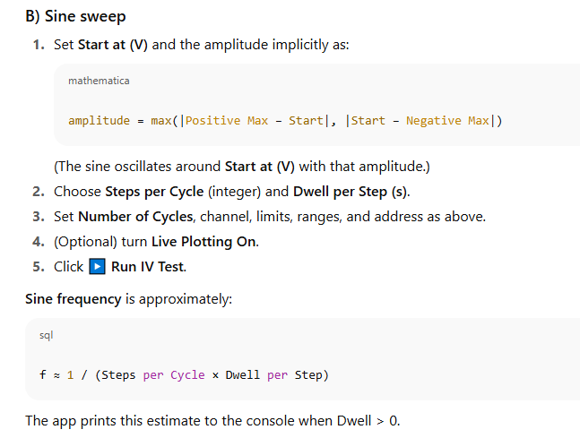
Typical workflows (Sine Wave)
Note: Because of Keithley communication latency, setting dwell per step to 0 still yields an effective point spacing of ~25 ms.

Slide 12

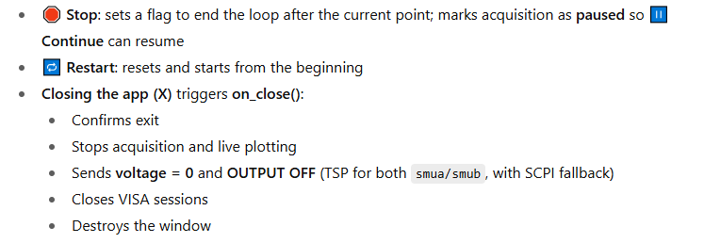
Safety & shutdown

Slide 13
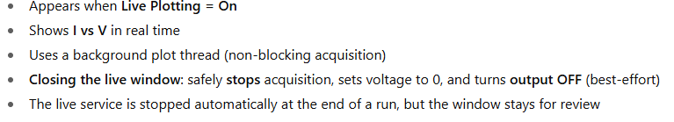
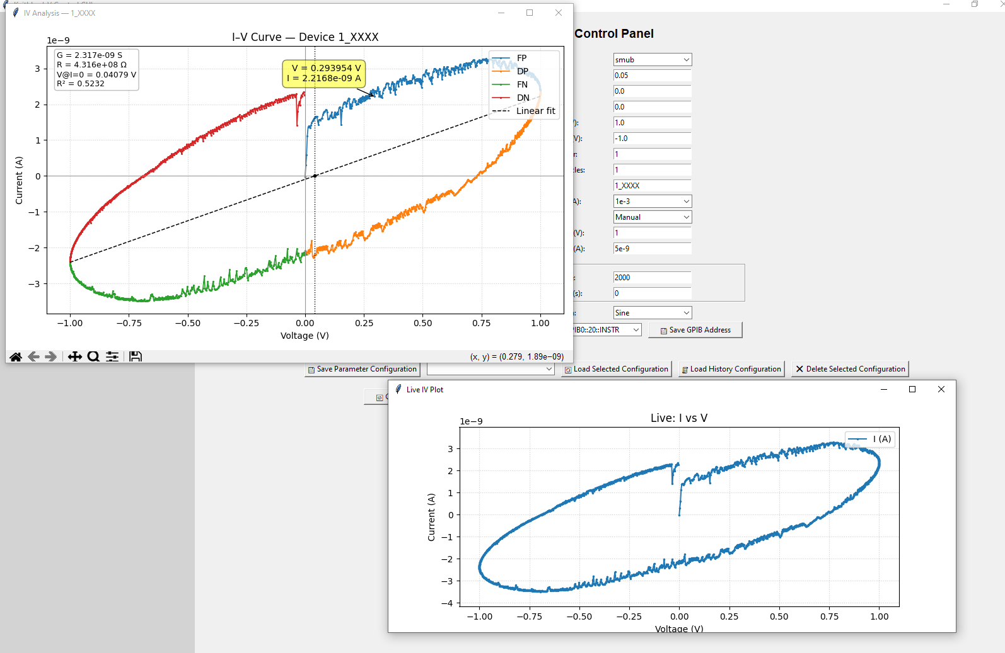
Live I–V window (popup)
Note: In this version, the live plot runs from a separate .py file.
Dragging or interacting with the plot window won’t affect the measurement and data acquisition.

Slide 14
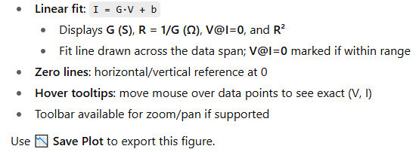
Final analysis window (auto-opens after a run)
Analysis contains
Segments FP/DP/FN/DN in different colors
You can zoom the graph in selected region here

Slide 15

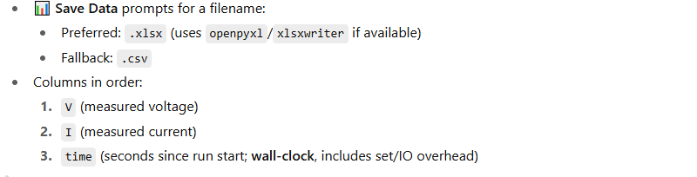
Data saving

Slide 16
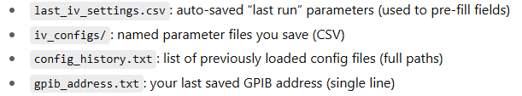
Configuration & persistence files

Slide 17
Troubleshooting & FAQs

